Slide 1
Forms of Energy

Slide 2
How are force, motion, and energy related?

Slide 3
What does potential mean?
What does energy mean?
What is potential energy mean?
Notes:
The goal is for the students to connect the words “potential,” “kinetic” and “energy” to the concepts of potential and kinetic energy. You could hold up a ping pong ball in each hand at different heights and ask which ping pong ball has the most potential energy, or demonstrate with one ping pong ball about to be rolled off the counter vs. another one that is about to be rolled on the counter… which one has more potential energy, the one about to roll on the counter or the one about to roll off the counter?

Slide 4
What does kinetic mean?
What does energy mean?
What does kinetic energy mean?
How are kinetic and potential energy related?
Notes:
The goal is for the students to connect the words “potential,” “kinetic” and “energy” to the concepts of potential and kinetic energy. You could hold up a ping pong ball in each hand at different heights and ask which ping pong ball has the most potential energy, or demonstrate with one ping pong ball about to be rolled off the counter vs. another one that is about to be rolled on the counter… which one has more potential energy, the one about to roll on the counter or the one about to roll off the counter?

Slide 6
Notes from Video
The law of Conservation of energy
energy can not be created
energy can not be destroyed destroyed
It can only be converted into one form or another (example of the solar hat)
Potential Energy
Energy due to position
Kinetic Energy
Due to motion
Draw Picture- Showing the conversion of potential into kinetic energy (using the example of the tire swing)

Slide 7
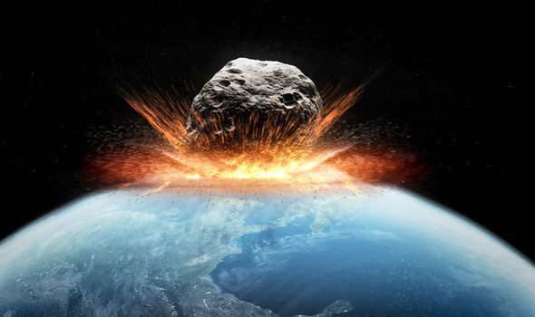
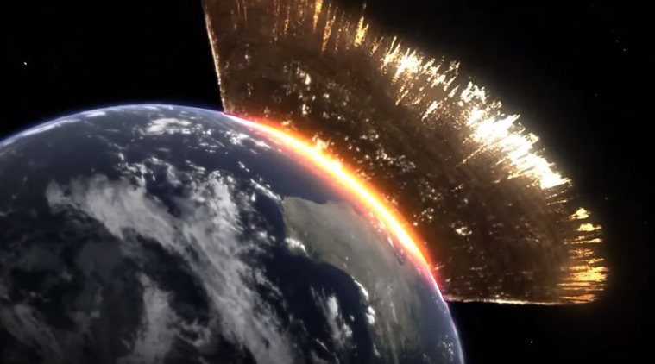
If we were looking at the Earth's surface in relation an asteroid colliding, when would the dirt (earth's surface) have the highest potential energy?
Notes:
We want the students to focus on the dirt and not the asteroid, to see that during the collision there is the most potential energy. After the collision, the dirt is moving (flying out) causing it to lose its potential energy and transfer it into kinetic energy.

Slide 8
If we were looking at the Earth's surface in relation an asteroid colliding, when would the dirt (Earth's surface) have the highest kinetic energy?

Slide 9
Give an of example of something experiencing a force...
In relation to the asteroid colliding with earth, what is experiencing a force?
Define what the word force means...
Notes:
Tie this back to the asteroid colliding with earth. Ask the students what is experiencing a force (between the asteroid colliding with earth).

Slide 11
Notes from Video
Force
Push or pull applied on a object
It can move stationary object or stop a moving object
Force can also change the speed and direction of a moving object
If enough force is applied, it can also change the shape and or size of an object

