Slide 1
The Laws of Stratigraphy

Slide 2
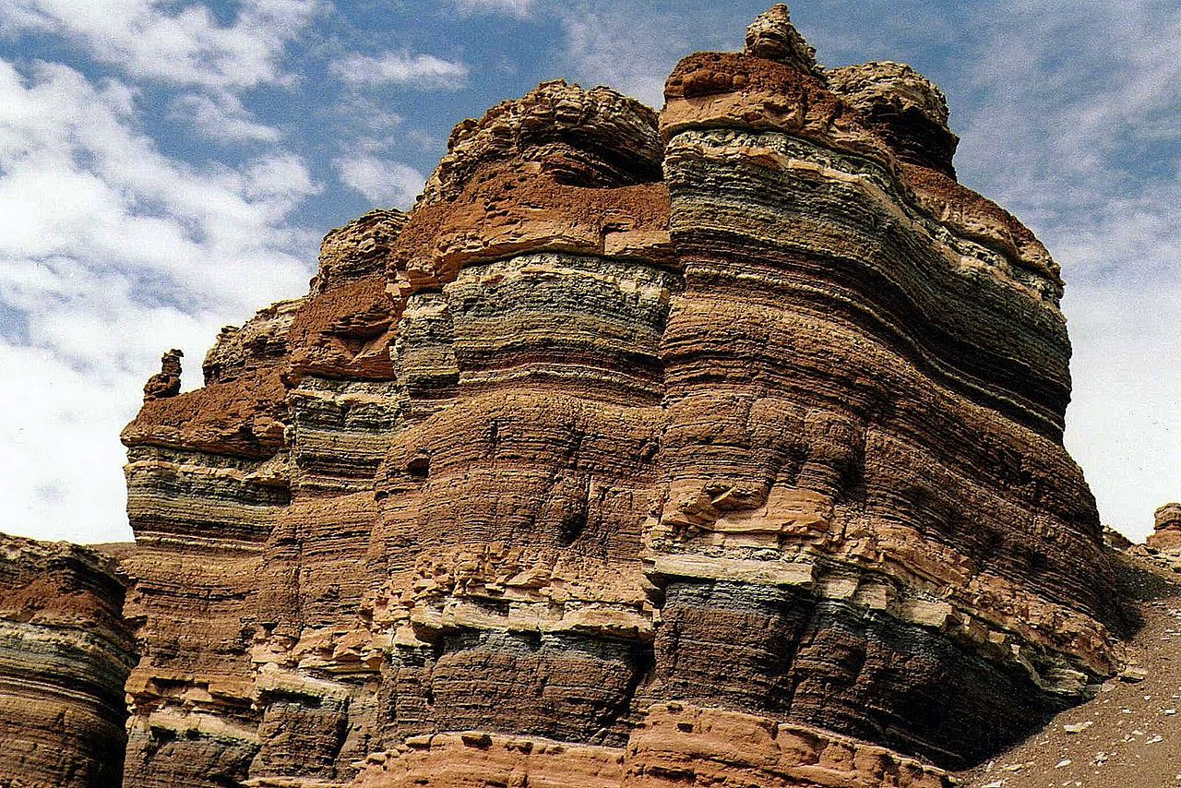
Stratigraphy
The study of rock layers
Rock layers are formed from the bottom up
Youngest rock on top
Oldest rock on bottom

Slide 3
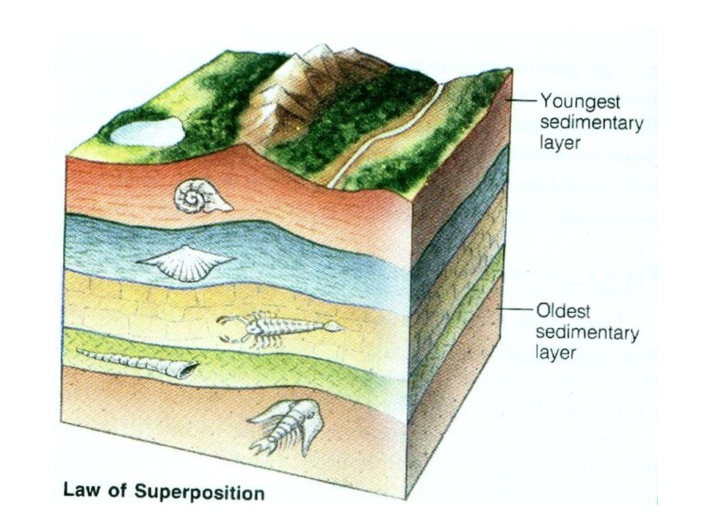
Law of Superposition
Superposition refers to the position of rock layers and their relative ages.
Relative age means age in comparison with other rocks, either younger or older.

Slide 4
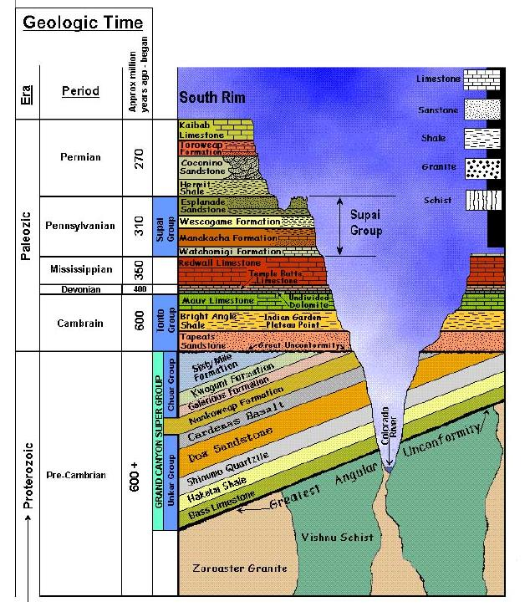
270 Million Years Old
YOUNGER
OLDER
600+ Million Years Old
Notes:
Here is a picture from the Grand Canyon showing different layers and an
unconformity. You can tell which rocks are older because the oldest rocks are
on the bottom. We call this “relative dating” because it describes the
relationship between the ages and positions of different layers.
Another way geologists can tell about a sequence of events is by using
radiometric dating. You’ve probably heard of carbon-14 dating, but there are
all sorts of elements that radioactively decay over time. Carbon is not very
abundant in most rocks, so we can’t use carbon-14 dating. Instead, most rock
ages are determined using the decay of Uranium, or sometimes other elements.
These radiometric clocks, when properly calibrated, tell us the age in years of a
given layer of rock. Oldest layers are still on the bottom, but now we know
exactly HOW old.

Slide 5
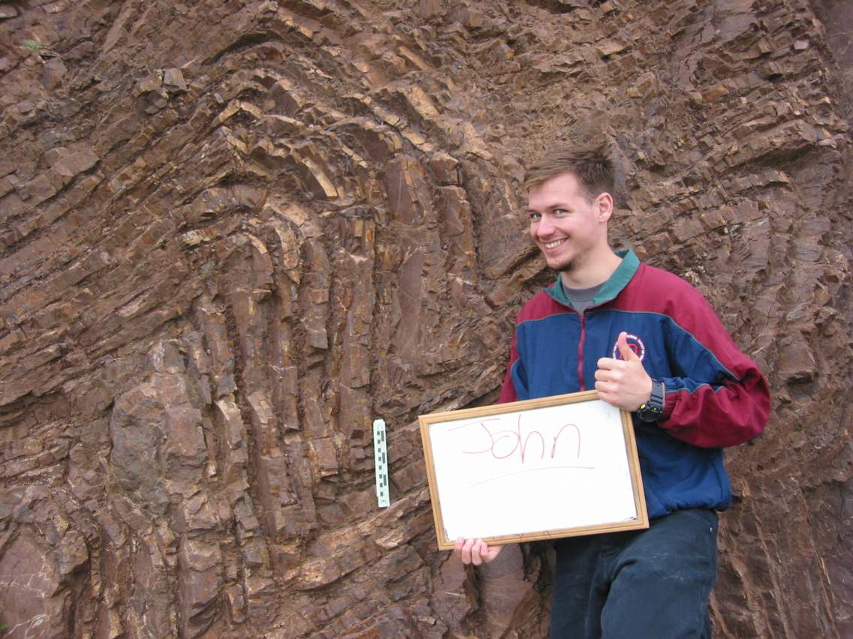
Law of Original Horizontality
Fold
Sediments were deposited in ancient seas in horizontal, or flat, layers. If sedimentary rock layers are tilted, they must have moved after they were deposited.

Slide 6
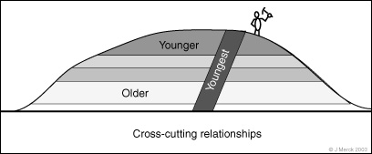
Law of Cross-Cutting Relationships
Rock layers may have another rock cutting across them, like igneous rock or a fault line.

Slide 7
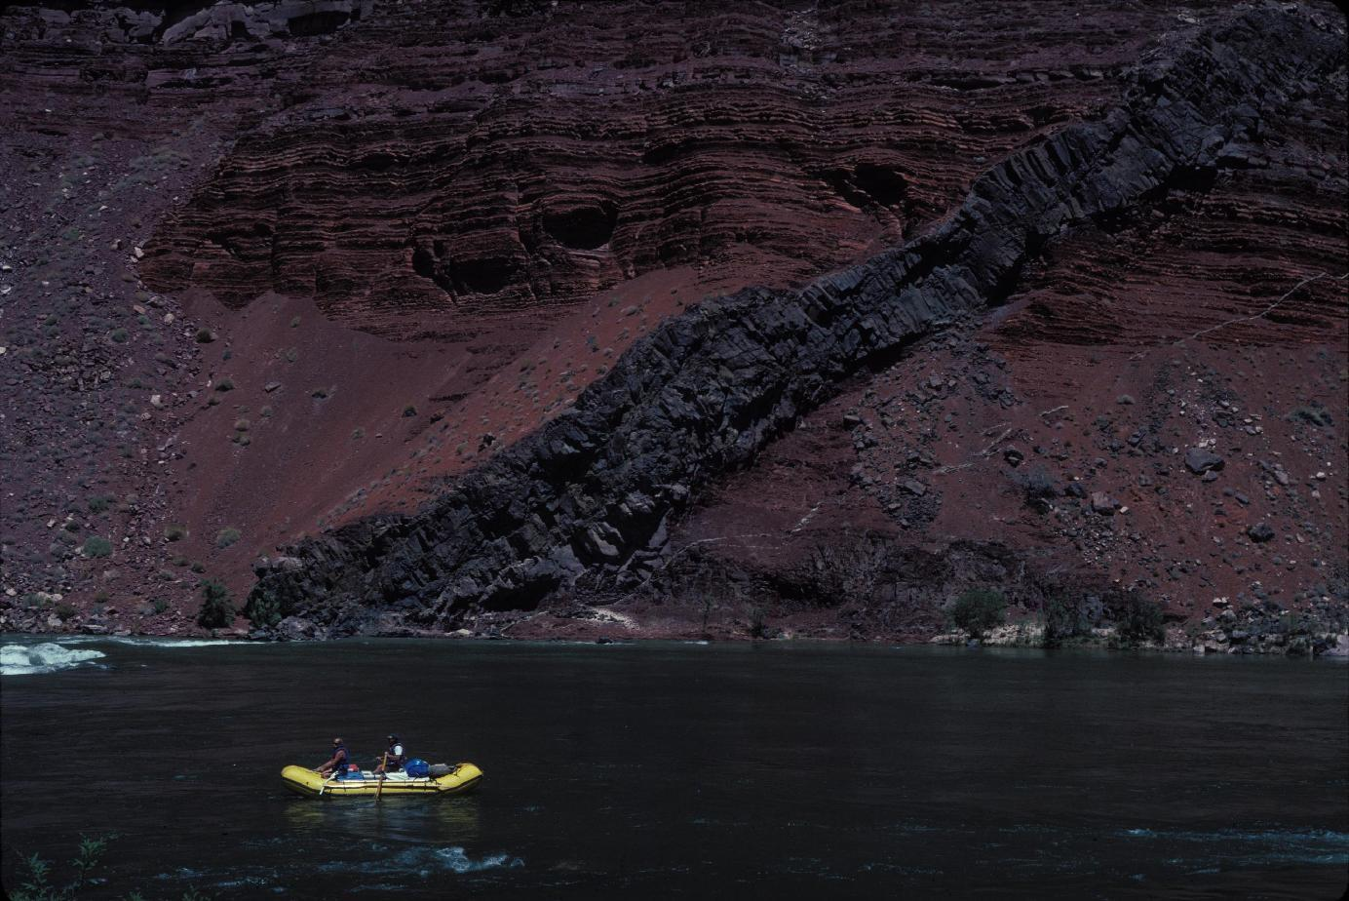
Cross Cutting
MOST RECENT
Notes:
Sometimes, layers get cut by something else. Here, the reddish-brown layers
were deposited flat. Then, the dark layer cut across all the other layers. It is
younger, because you can’t cut layers until they have all been deposited. This
dark object was originally molten magma that was squeezed into the layers as
it fought its way towards the surface. It eventually solidified, forming what you
see here.

Slide 8
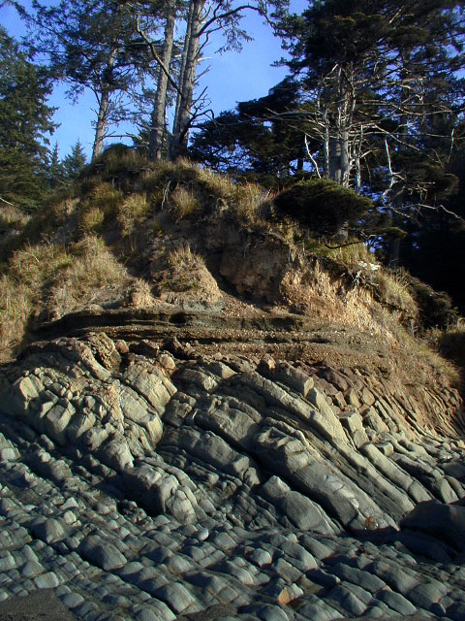
Unconformity
Sometimes, layers give an indication of many different events. First, there was a set of layers laid down flat. Then, they got tilted, like the flatirons in a previous photo. Over time, the tips of the layers got eroded down into a new, flat surface. Then, another set of flat layers got deposited on top.

Slide 9
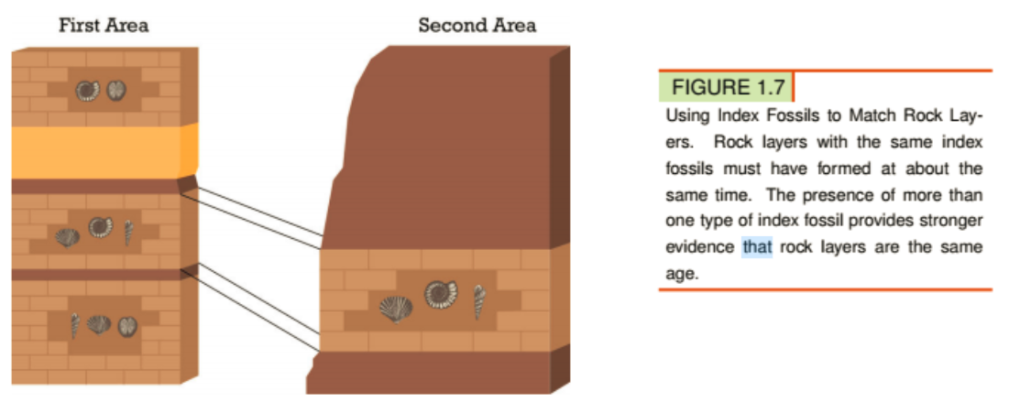
Index Fossils
Index fossils are commonly used to match rock layers in different places. You can see how this works in Figure 1.7.
If two rock layers have the same index fossils, then they’re probably about the same age.

Slide 10
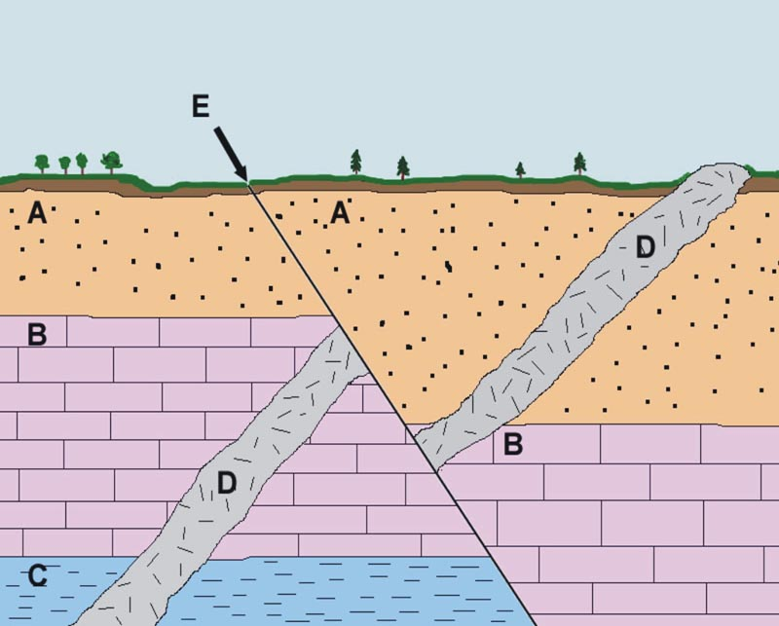
Which rock layer is the oldest?

Slide 11
Which rock layer is the oldest?
Answer: Rock Layer C
Because layer C is the lowest layer

Slide 12
Which rock layer is the next oldest layer after C?

Slide 13
Which rock layer is the next oldest layer after C?
Answer: Layer B
Because the rock layer is on top of layer C which means it had to come after.

Slide 14
Which rock layer is the next oldest layer after
B?

Slide 15
Which rock layer is the next oldest layer after
B?
Answer: Layer A
Because it is on top of layer B which means it had to come after.

Slide 16
Which rock layer is the next oldest layer after
A?

Slide 17
Which rock layer is the next oldest layer after
A?
Answer: Intrusion D
Because it cuts through the older layers A-B. The fault (E) cuts through the intrusion (D) which means it had to come after the intrusion (D)

